Slide 1
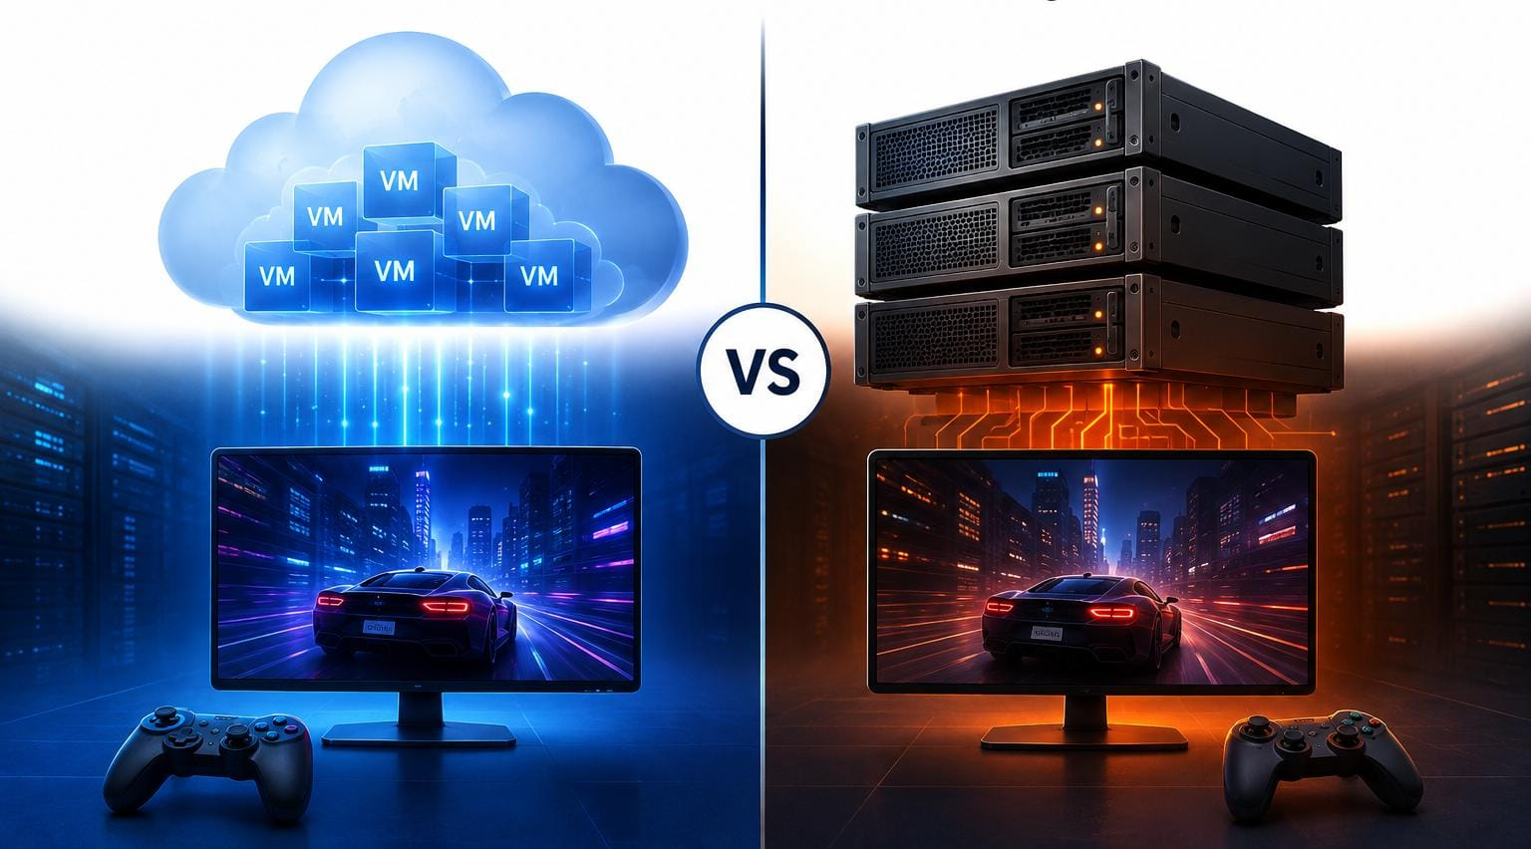

Performance Comparison of Virtualized and Traditional Cloud Gaming Infrastructure
Supervisor:
Dr. Govindasamy C
Presented by:
Juhi Surin (192525148)
Kavya Jasmine V (192521133)
Sana Fatima M (192371082)
Yenike Manasa Sai (192473023)
SLIDE -1

Slide 2


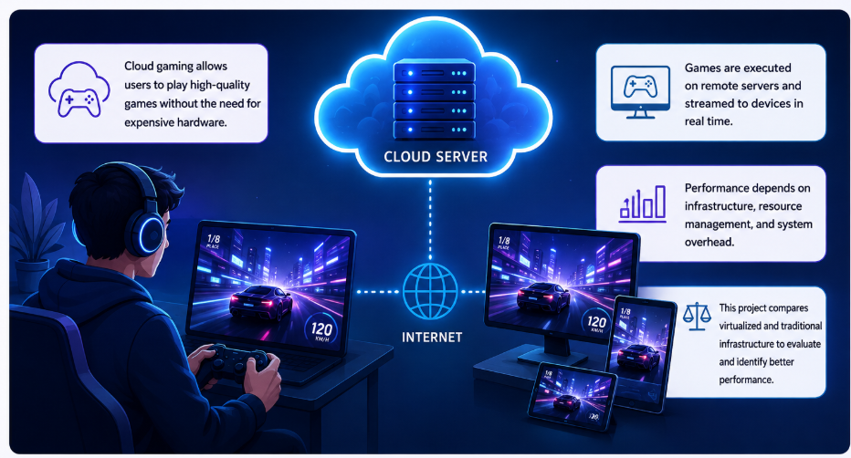
INTRODUCTION
Cloud gaming allows users to play games remotely using powerful cloud computing resources.
Virtualization enables multiple gaming environments to share and manage cloud resources efficiently.
Traditional cloud gaming runs applications directly on the available server infrastructure.
This project compares both approaches using measurable performance parameters.
The study combines cloud computing with big data analytics for data-driven evaluation.
SLIDE -2

Slide 3
OBJECTIVES
To implement a cloud gaming environment for remote game execution and streaming.
To create both virtualized and traditional gaming environments under comparable conditions.
To collect performance metrics such as latency, FPS, CPU, memory, and network usage.
To analyze the collected data using big data analytics techniques.
To compare both environments and identify the more efficient infrastructure.
SLIDE -3

Slide 4
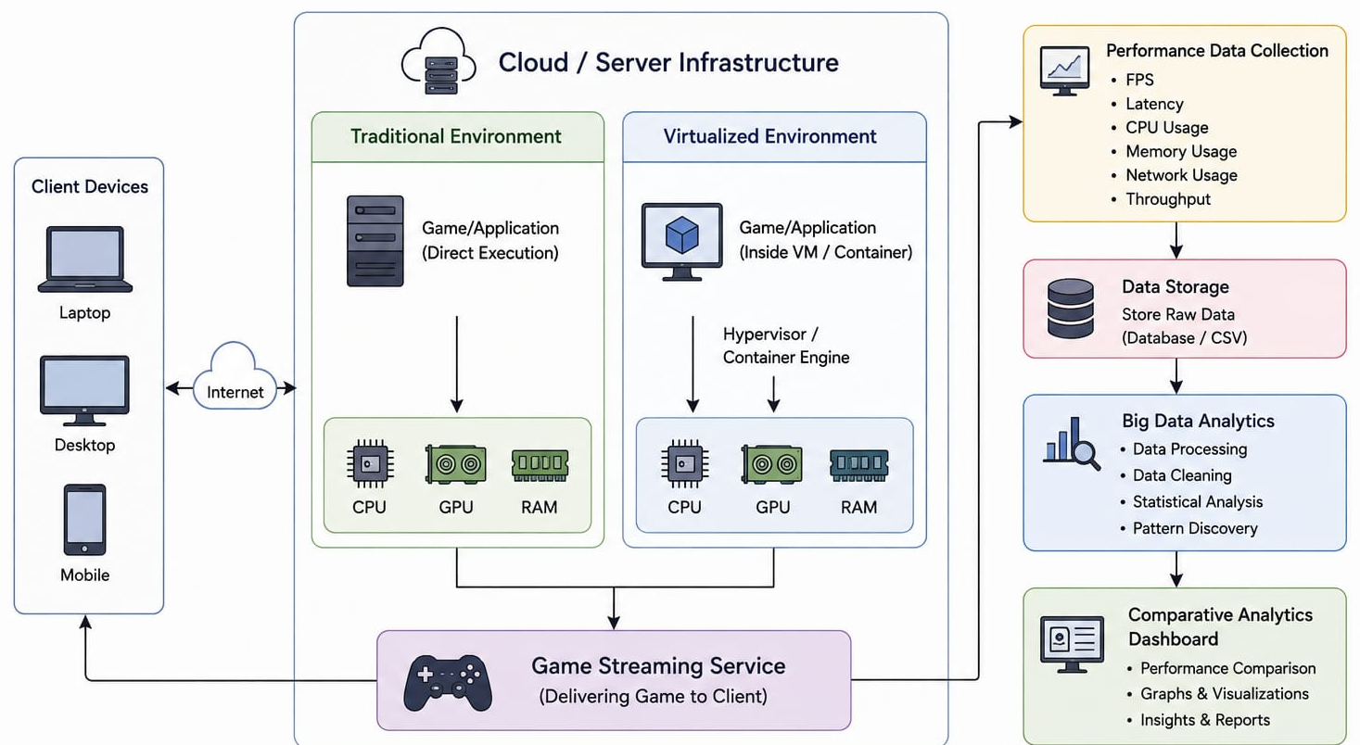
SYSTEM ARCHITECTURE
SLIDE -4

Slide 5
MODULE 1-Cloud Gaming Infrastructure Setup
A cloud or server environment is configured with the required computing resources.
The required operating system, GPU drivers, and gaming software are installed.
A remote game streaming service is configured for client access.
The client device connects to the server through a network connection.
The infrastructure is tested to ensure stable game execution and streaming.
SLIDE -5

Slide 6
MODULE 2- Virtualized & Traditional Environment Implementation
The traditional environment runs the game directly on the host operating system.
The virtualized environment runs the same game inside a virtualized container or environment.
Both environments are configured with comparable computing and network resources.
The same game and workload are used to ensure a fair performance comparison.
Both environments are executed repeatedly to obtain reliable experimental results.
SLIDE -6

Slide 7
MODULE 3-Performance Data Collection & Big Data Analytics
Performance data is continuously collected from both gaming environments.
Metrics such as FPS, latency, CPU, memory, GPU, and bandwidth are recorded.
The collected data is stored in structured datasets for further processing.
Data analytics techniques are used to identify performance patterns and variations.
The results are statistically analysed to determine the differences between both environments.
SLIDE -7

Slide 8
MODULE 4-Comparative Analytics Dashboard
An interactive dashboard displays the collected performance metrics.
Users can compare virtualized and traditional environments using different parameters.
Graphs and charts visualize FPS, latency, resource utilization, and network performance.
The dashboard highlights performance differences under different workloads.
The final comparison helps identify the more efficient cloud gaming infrastructure.
SLIDE -8

Slide 9
RESULT & DISCUSSION
The system successfully implements both virtualized and traditional cloud gaming environments.
Performance metrics are successfully collected from both environments.
The collected data provides measurable differences in gaming and resource performance.
Analytics and visualizations clearly represent the performance comparison.
The final results identify the strengths and limitations of each infrastructure.
SLIDE -9

Slide 10
ADVANTAGES
It provides a practical comparison between virtualized and traditional infrastructure.
It uses real performance metrics instead of relying only on theoretical analysis.
Big data analytics enables efficient analysis of large performance datasets.
The dashboard provides an easy-to-understand visualization of experimental results.
The approach helps identify resource utilization and performance bottlenecks.
SLIDE -10

Slide 11
APPLICATIONS
The system can be used to evaluate cloud gaming service performance.
It can help cloud providers optimize computing and GPU resource allocation.
Gaming companies can use the analysis to select suitable deployment environments.
It can support research on virtualization and cloud resource management.
The system can be extended for testing other resource-intensive cloud applications.
SLIDE -11

Slide 12
FUTURE SCOPE
The system can be extended to multiple cloud platforms for broader comparison.
AI-based prediction can be added to forecast gaming performance under different workloads.
Dynamic resource allocation can be implemented to improve cloud gaming efficiency.
Multi-user testing can be expanded to evaluate large-scale cloud gaming scenarios.
Advanced analytics can be used to optimize latency, resource usage, and scalability.
SLIDE -12

Slide 13
CONCLUSION
The project provides a practical framework for comparing virtualized and traditional cloud gaming infrastructure.
It evaluates both environments using important gaming and resource performance metrics.
Big data analytics helps convert collected performance data into meaningful insights.
The comparative dashboard makes the results easier to understand and evaluate.
The project demonstrates how cloud infrastructure choices can influence cloud gaming performance.
SLIDE -13

Slide 14
REFERENCES
Gegout, A., Mvondo, D., Frey, D., & Monchon, P. (2025, June). Towards an Efficient Containerized Cloud Gaming Platform. In 2025 IEEE International Parallel and Distributed Processing Symposium Workshops (IPDPSW) (pp. 78-86). IEEE.
Lyu, M., Madanapalli, S. C., Vishwanath, A., & Sivaraman, V. (2024, March). Network anatomy and real-time measurement of nvidia geforce now cloud gaming. In International Conference on Passive and Active Network Measurement (pp. 61-91). Cham: Springer Nature Switzerland.
Tanveer, J., Abbas, S. K., Hasan, M. Z., Hussain, M. Z., Khalid, A., Ahmad, A., ... & Ali, Z. (2024, November). Advancing Cloud Gaming: Addressing Latency Challenges through Research and Innovative Solutions. In 2024 2nd International Conference on Advances in Computation, Communication and Information Technology (ICAICCIT) (Vol. 1, pp. 1284-1289). IEEE.
De Oliveira, S. S., Souza, C. H. R., Silva, J. C., & Carvalho, S. T. (2023, November). Towards scalable cloud gaming systems: Decoupling physics from the game engine. In Proceedings of the 22nd Brazilian Symposium on Games and Digital Entertainment (pp. 151-160).
Baloni, D., Bhatt, C., Kumar, S., Patel, P., & Singh, T. (2023, November). The Evolution of Virtualization and Cloud Computing in the Modern Computer Era. In 2023 International Conference on Communication, Security and Artificial Intelligence (ICCSAI) (pp. 625-630). IEEE.
Lambropoulos, G., Mitropoulos, S., & Douligeris, C. (2026). Emerging technologies in financial services: From virtualization and cloud infrastructures to edge computing applications. Computers, 15(1), 41.
SLIDE -14

Slide 15
THANK YOU

Slide 16
